Slide 1


Supervisor Meeting 1
Team Name: Kaitodkrob Colour: Cyan Section: G6 Team 1
Team Members:
Brendon Koh Keng Siong Project Manager
Tan Kah Sheng (Zack) Secretary
Alvin Tan Yong Ming Member
Mui Soon Wan (Teresa) Member
Dawn Tan Member
Ananphumtriphop Turian (Lin) Member

Slide 2

Agenda
Functions Overview
Important Deadlines
Planned Schedule
Role Rotation Plan
Critical Path
Iteration 1 Breakdown
Schedule Metrics
Issues Faced & Mitigation Plan

Slide 3

Functions Overview
Login (Blue)
Basic App Usage Report (Blue)
Top-k App Usage Report (Blue)
Smartphone Overuse Report (Blue)
Dual Interfaces (Web UI and Web Services) (Blue)
Loading Location Data (Green)
Deletion of Data (Green)
Smartphone Usage Heatmap (Green)
Social Activeness Report (Green)

Slide 4

Important Deadlines
Week Number | Assessment | Project Manager
6 | Supervisor Meeting 1 | Brendon
7 | PM Review | Teresa
9 | Supervisor Meeting 2 | Zack
11 | Supervisor Meeting 3 | Lin
12 | User Acceptance Test | Dawn
14 | Final Presentation | Alvin

Slide 5


Planned Schedule
Current Upcoming
3. Basic App Usage Report Function
4. Top-k App Usage Report Function
5. Smartphone Usage Heatmap Function
1. Software Designs Use Case Logical Diagram Class Diagram Sequence Diagrams
6. Social Activeness Report Function
2. Login & Bootstrap Function
1
2
3
4
5
6
14 Sep- 21Sep 21 Sep - 01 Oct 01 Oct - 12 Oct 12 Oct - 22 Oct 22 Oct - 28 Oct 28 Oct - 3 Nov
For Iterations 2 to 6
Implement Functions’ Logic, CRUD and User Interface
Design Test Case
Perform UAT
Make relevant changes to design diagrams
Update members on changes

Slide 6
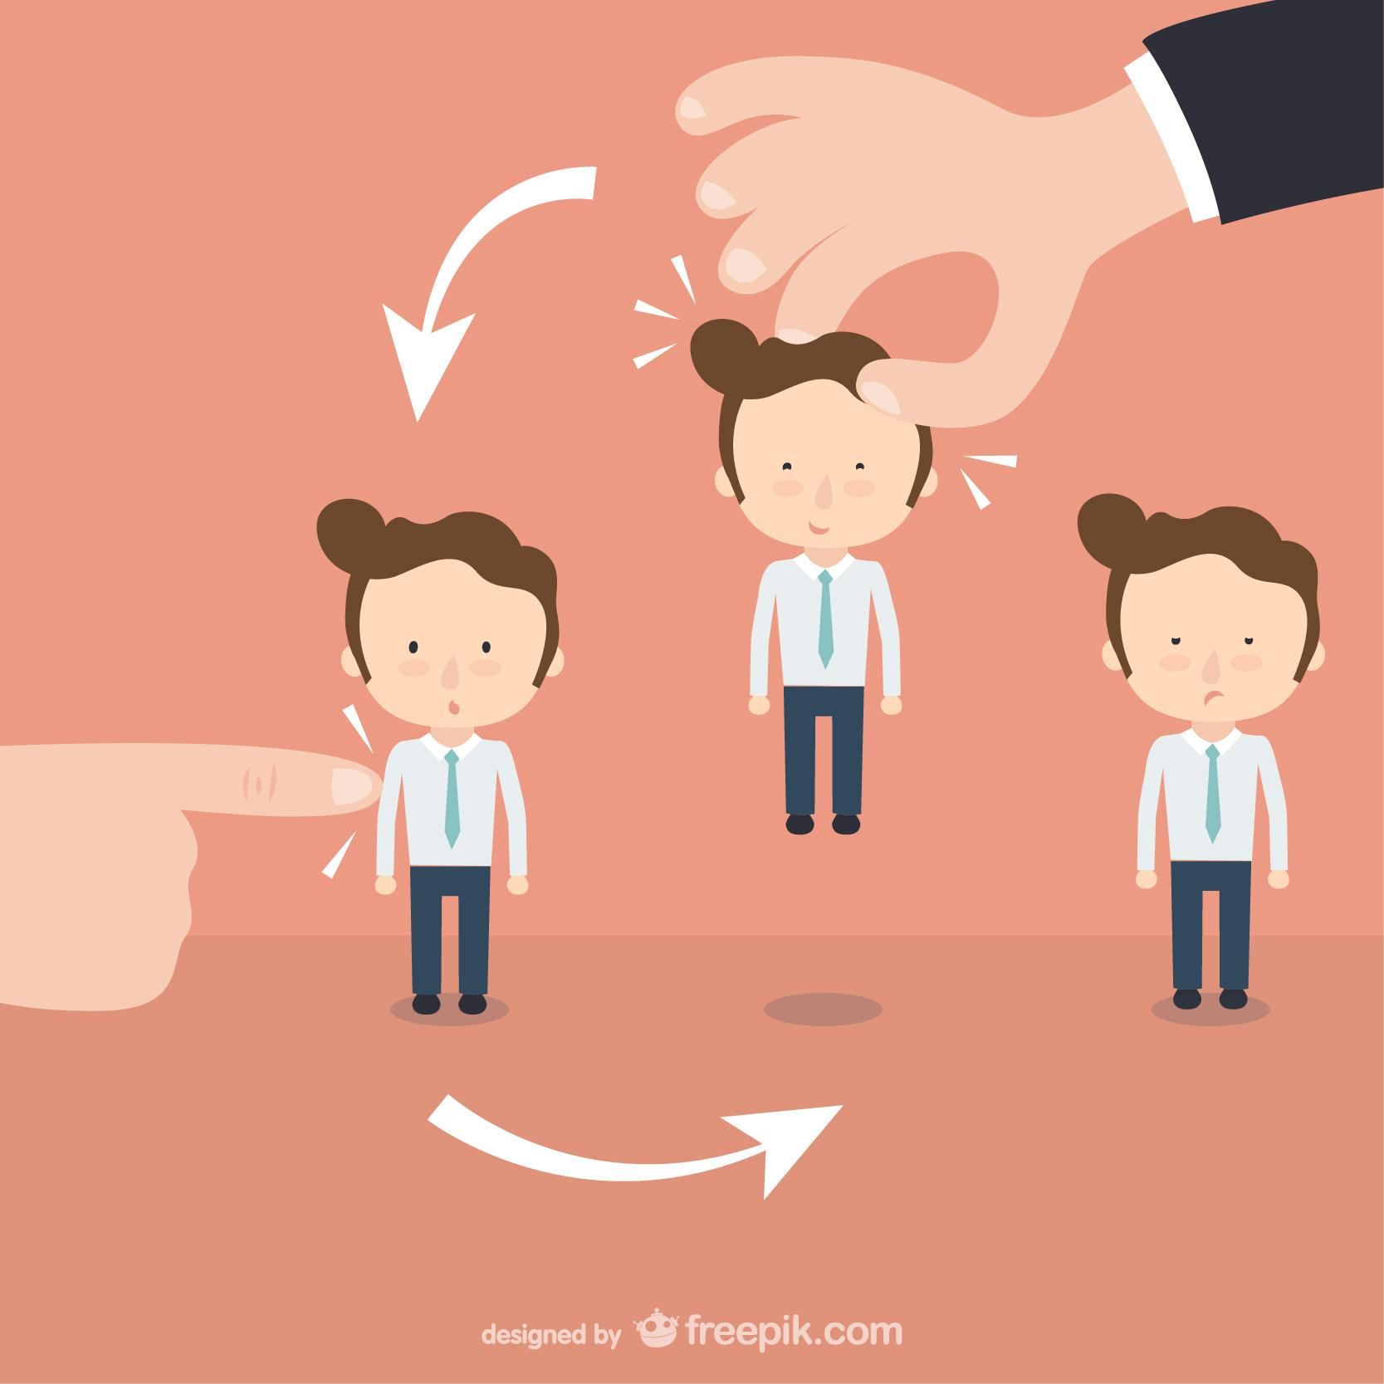
Role Rotation Plan
Iteration | Project Manager | Secretary | Pair 1 | Pair 2 | Pair 3
1 | Brendon | Zack | Lin & Teresa | Dawn & Brendon | Zack & Alvin
2 | Teresa | Brendon | Brendon & Lin | Zack & Teresa | Dawn & Alvin
3 | Zack | Dawn | Zack & Alvin | Lin & Dawn | Teresa & Brendon
4 | Lin | Teresa | Dawn & Teresa | Brendon & Zack | Lin & Alvin
5 | Dawn | Alvin | Dawn & Zack | Brendon & Lin | Teresa & Alvin
6 | Alvin | Lin | Lin & Zack | Brendon & Alvin | Dawn & Teresa

Slide 7

Critical Path
Prepare slides for Supervisor Meeting 1 (3 days)
Basic App Report, Sequence Diagram
(3 days)
Use Case Diagram (1 day)
All diagrams are done
Class Diagram
(1 day)
Logical Diagram
(1 day)
Other Sequence Diagrams
(2 days)
Going through diagrams and standardize naming convention
(2 days)

Slide 8

Iteration 1 Breakdown & Progress
Task | Progress Status | Member Involved | Remarks
Use case diagram | 100% | Everyone
Logical diagram | 100% | Everyone
Class diagram | 40% | Everyone | Controller classes not included intentionally
Login & Bootstrap SD | 100% | Lin, Teresa
Basic app report & Social activeness SD | 70% | Alvin, Zack | Unsure if SD is correct. Will be confirmed upon coding.
Top-k report, Delete Location Data & Smartphone overuse report SD | 100% | Brendon, Dawn
Smartphone usage heatmap SD | 100% | Alvin, Zack
Prepare slides for Supervisor Meeting 1 | 100% | Brendon

Slide 9
Schedule Metrics (Iteration 1)
Estimated hours
32
Actual hours
35.1
Metrics
0.91
÷ =
Deviation (Day) = 0

Slide 10


Problems/Issues Faced (Iteration 1)
Problems/Issues | Mitigation
Different naming conventions | PM called for a meeting to standardize the conventions used. (e.g. method names & class names)
Difficult to estimate duration required for each PP session | We used pessimistic approach
Project group has to learn about new software required for the projects. (e.g. OpenShift & GitHub) | Learning time is included in schedule

Slide 11

Goals for Iteration 2
Task | Goal
Login UI and Logic | Fully functional
Bootstrap UI and Logic | Fully functional
Relevant diagrams | Updated

Slide 12

Q & A

